Slide 1
Bootcamp DevOps Dumbways
Khaerul Anwar
Persentasi Week 4

Slide 2
Materi
Monitoring Server
Setup Monitoring Server
Connect Multiple Server
Server Automation
Ansible for Server Automation
Deploy PHP Application
Deploy Sipeka Apllication

Slide 3
1.
TRANSITION HEADLINE
Let’s start with the first set of slides

Slide 4
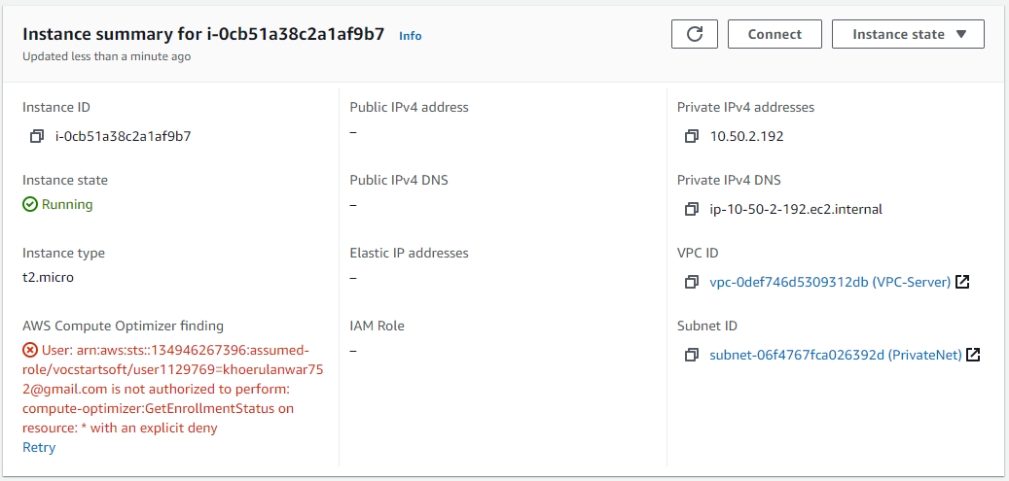
Monitoring Server

Slide 5
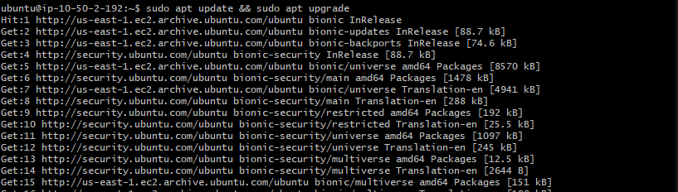
Monitoring Server

Slide 6
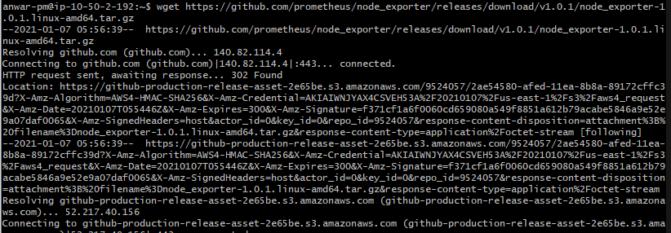
Monitoring Server

Slide 7
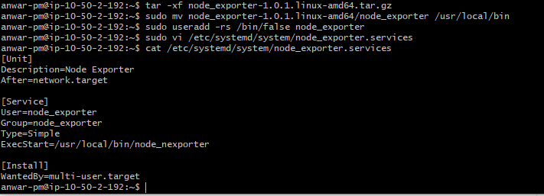
Monitoring Server

Slide 8
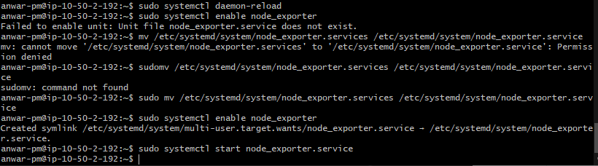
Monitoring Server

Slide 9
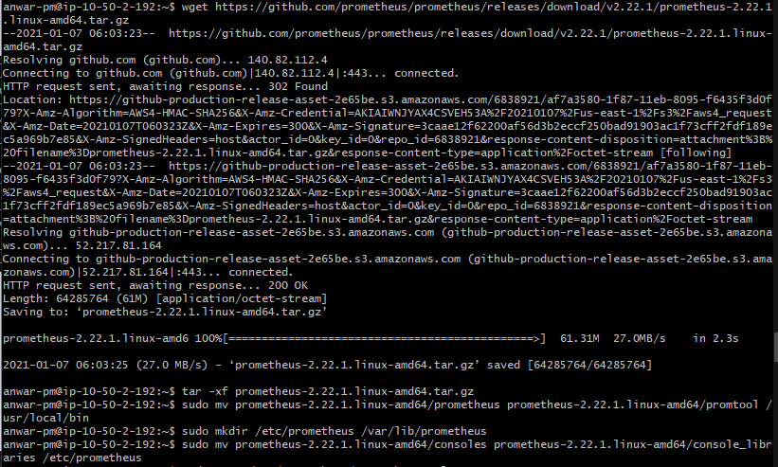
Monitoring Server

Slide 10
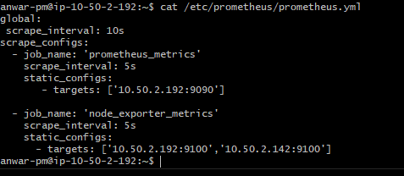
Monitoring Server

Slide 11
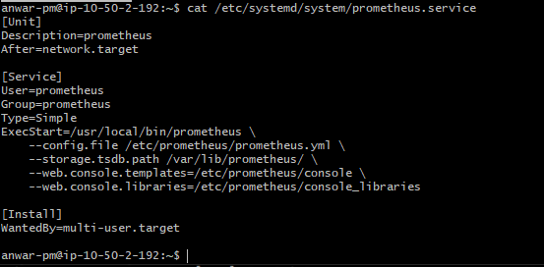
Monitoring Server

Slide 12
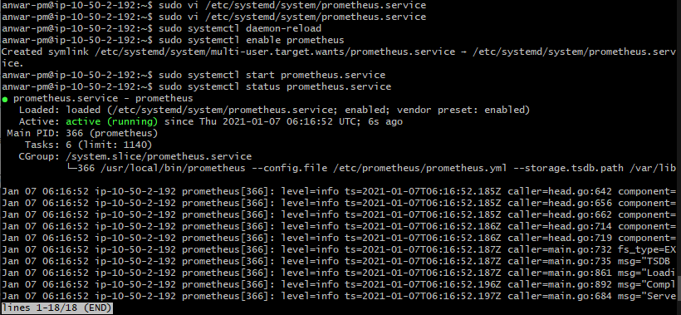
Monitoring Server

Slide 13
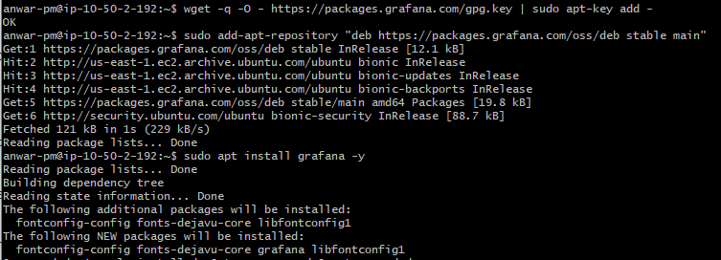
Monitoring Server

Slide 14
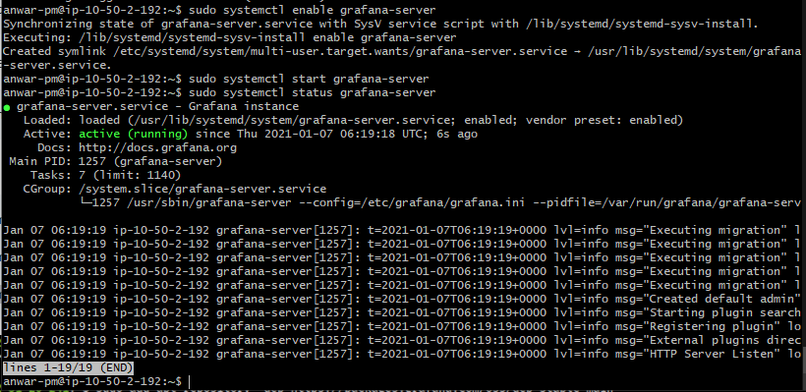
Monitoring Server

Slide 15
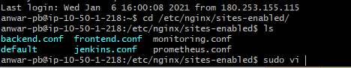
Monitoring Server

Slide 16
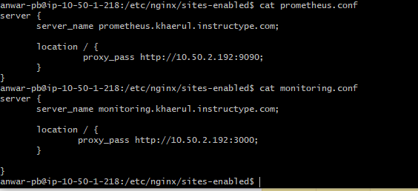
Monitoring Server

Slide 17
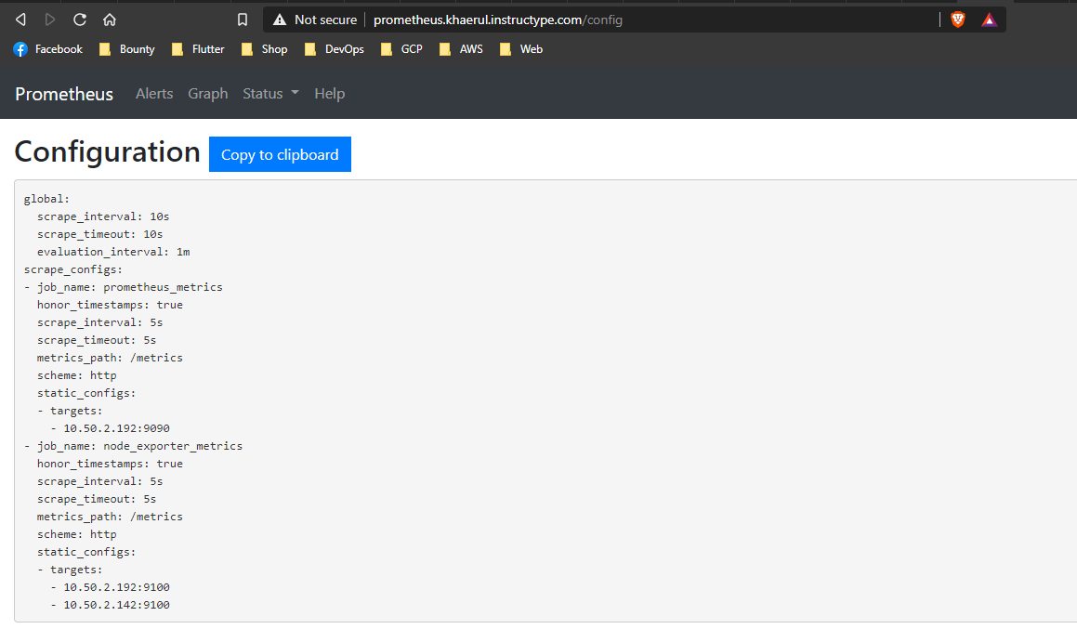
Monitoring Server

Slide 18
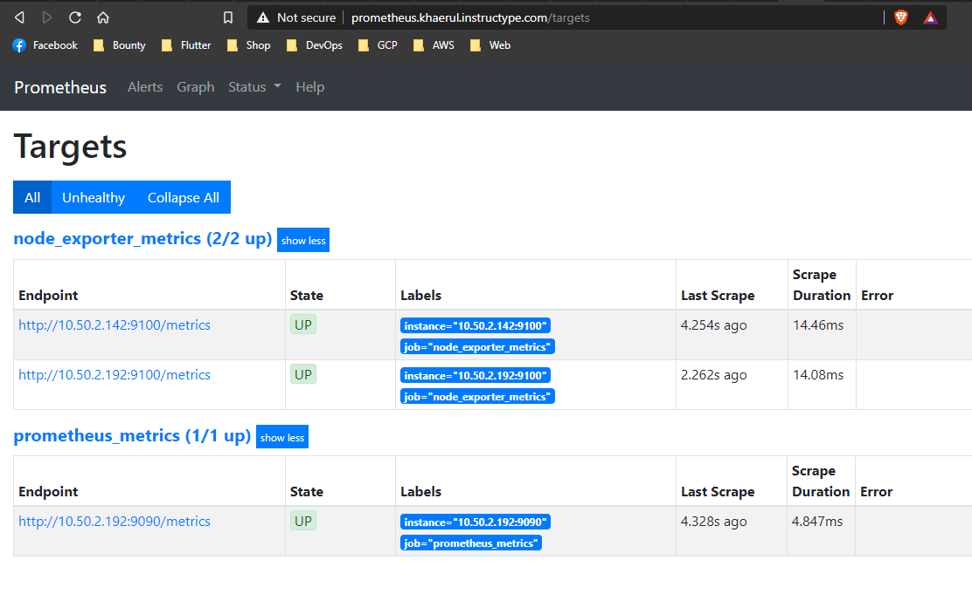
Monitoring Server

Slide 19
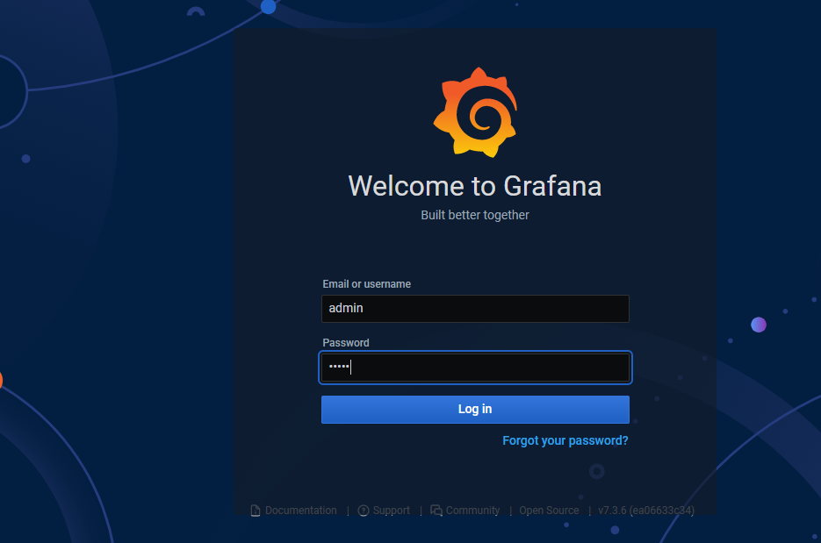
Monitoring Server

Slide 20
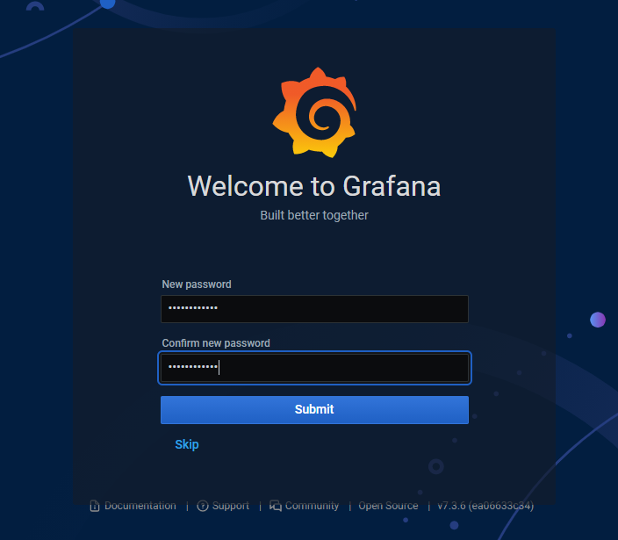
Monitoring Server

Slide 21
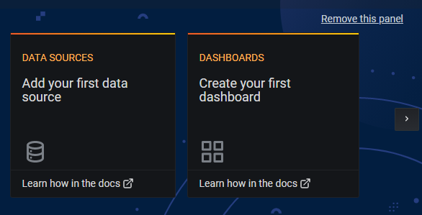
Monitoring Server

Slide 22
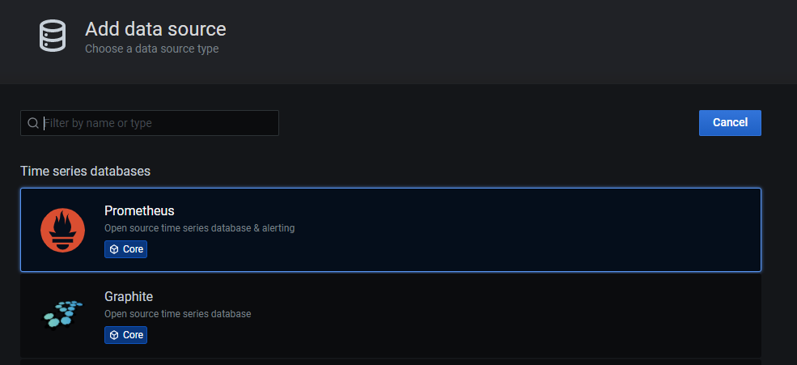
Monitoring Server

Slide 23
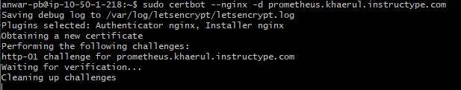
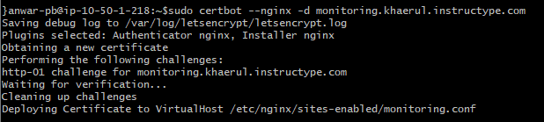
Monitoring Server

Slide 24
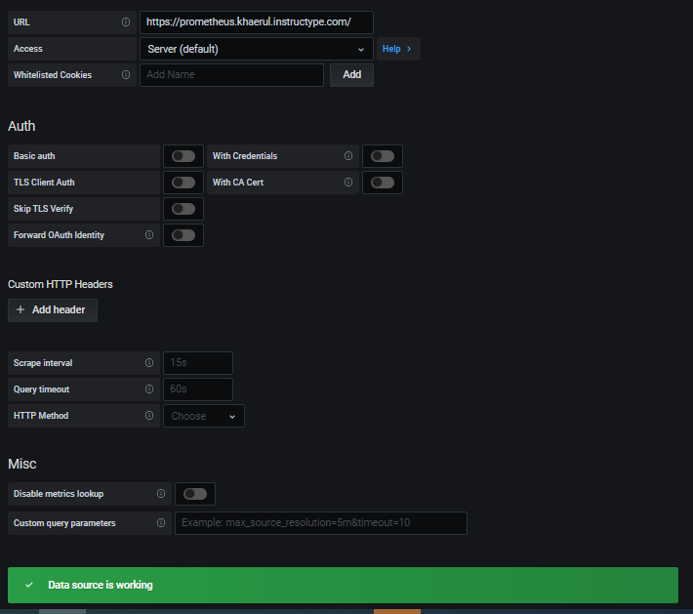
Monitoring Server

Slide 25
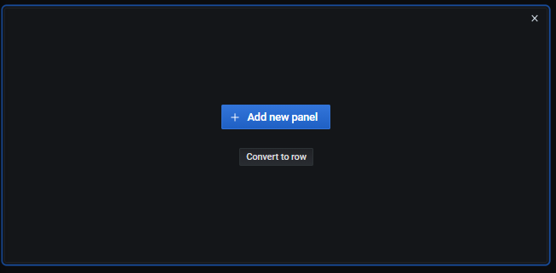
Monitoring Server

Slide 26
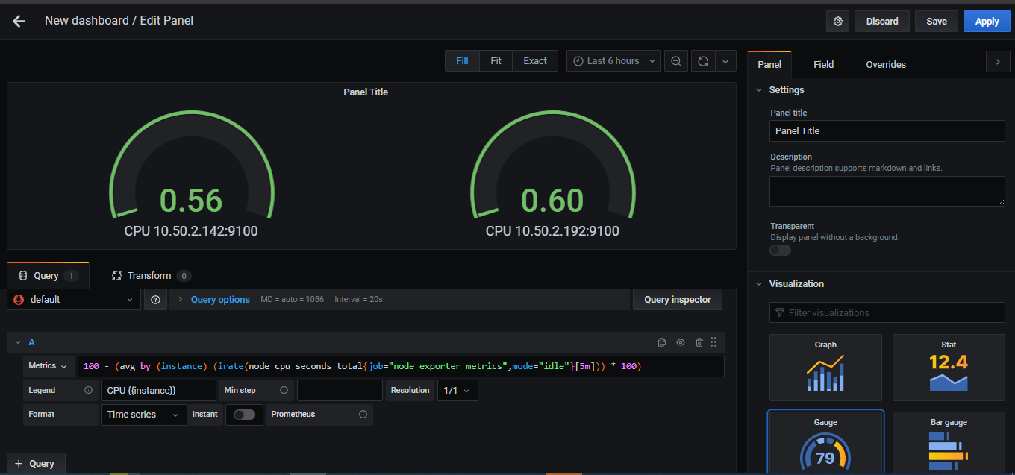
Monitoring Server

Slide 27
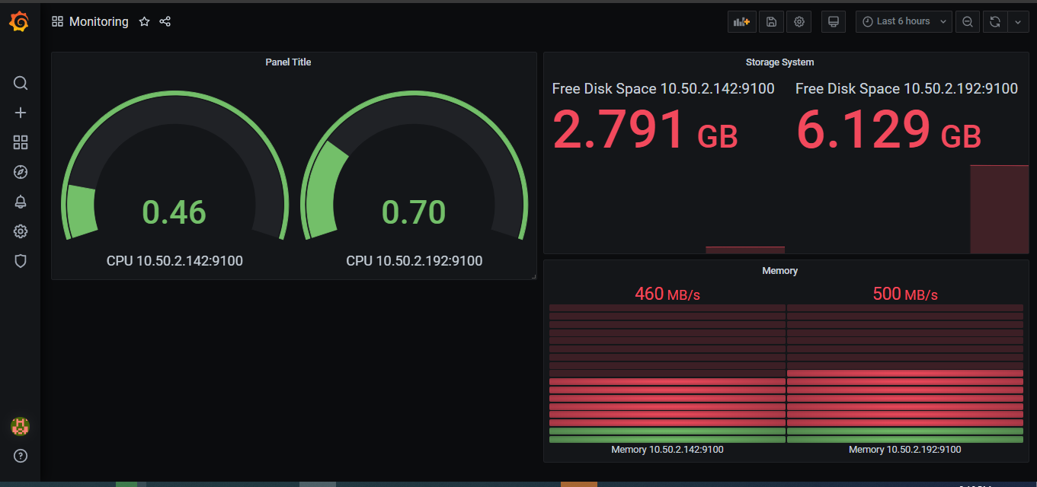
Monitoring Server

Slide 28
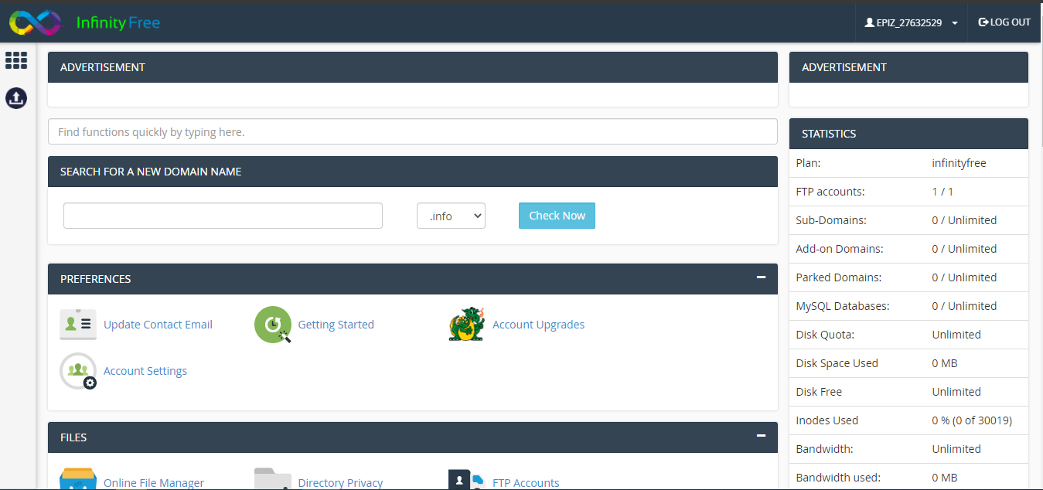
Cpanel – Deploy PHP Application

Slide 29
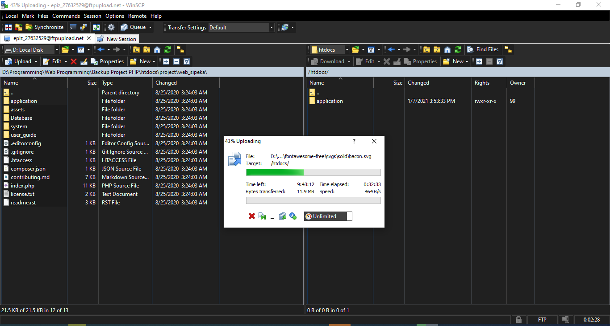
Cpanel – Deploy PHP Application

Slide 30
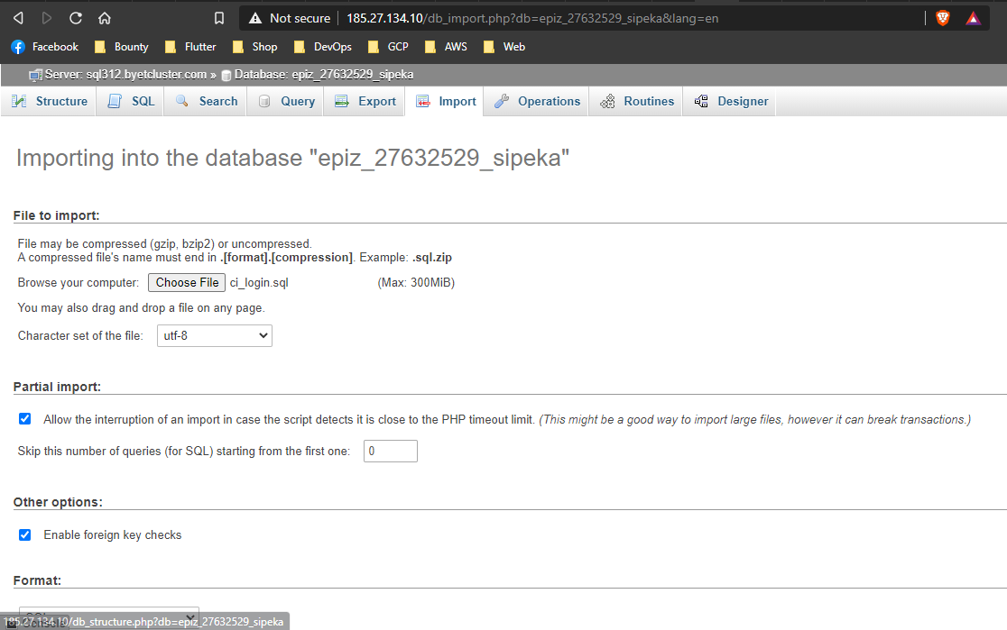
Cpanel – Deploy PHP Application

Slide 31
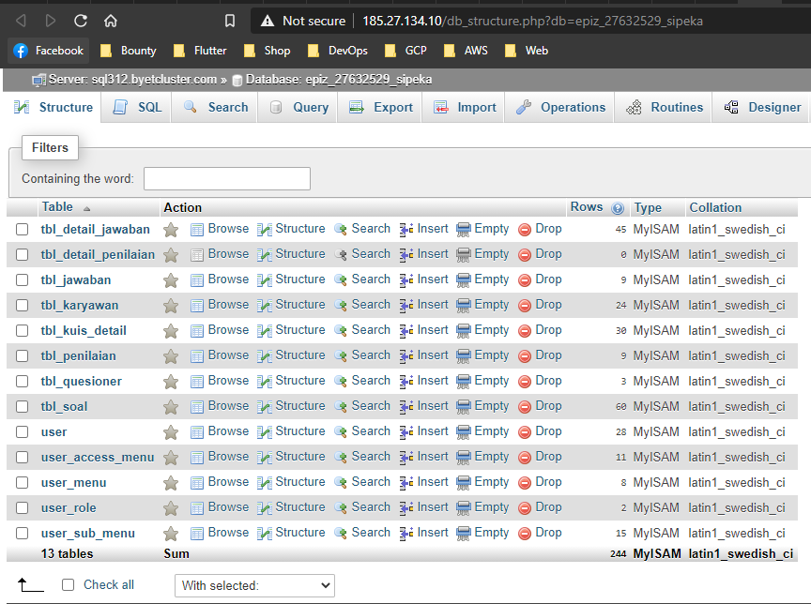
Cpanel – Deploy PHP Application

Slide 32
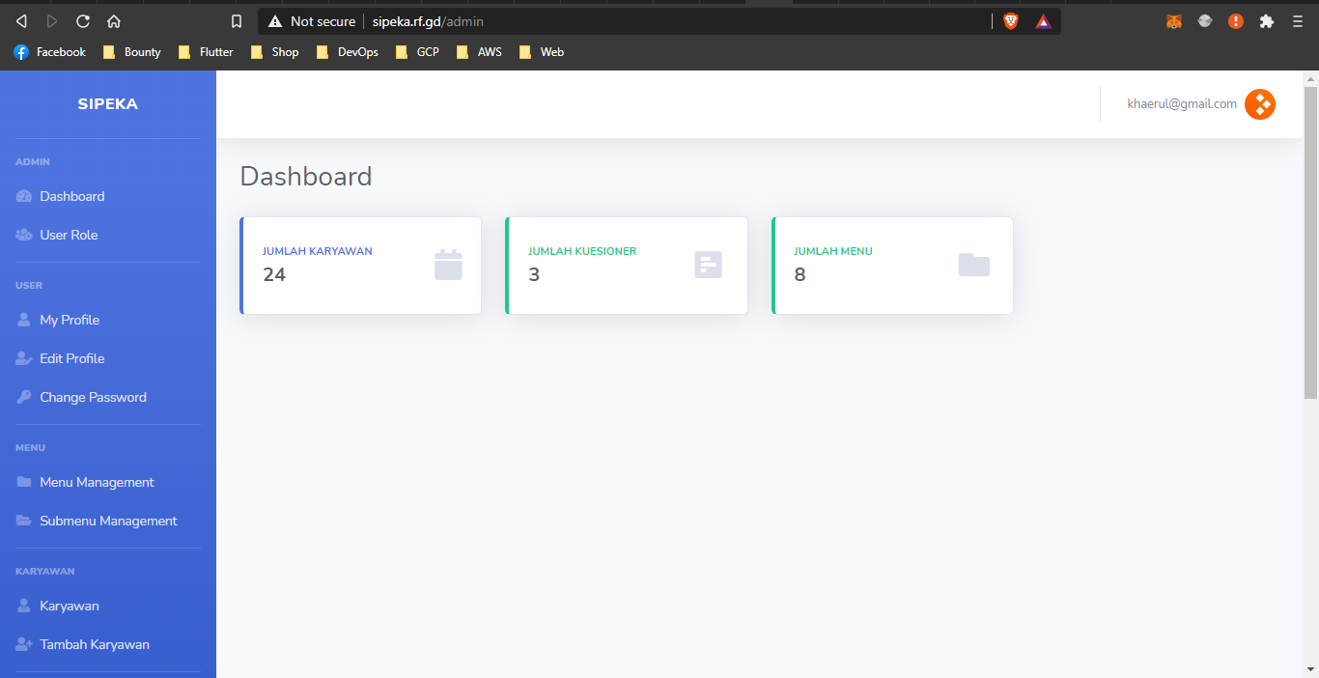
Cpanel – Deploy PHP Application

Slide 33
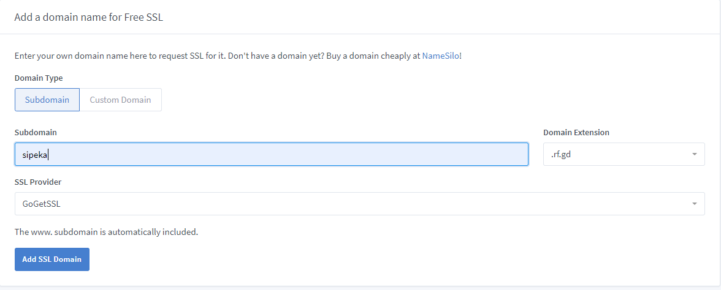
Cpanel – Deploy PHP Application

Slide 34
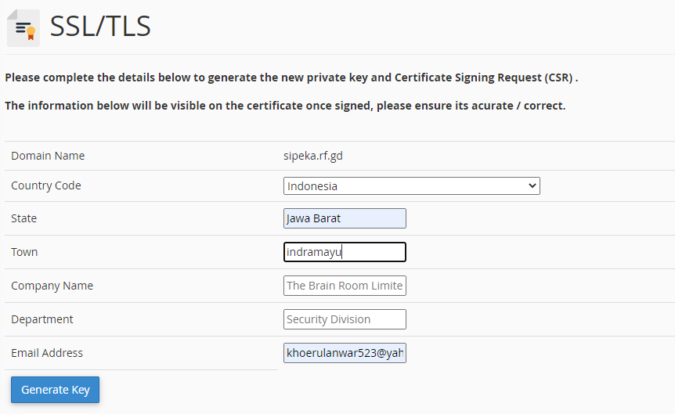
Cpanel – Deploy PHP Application

Slide 35
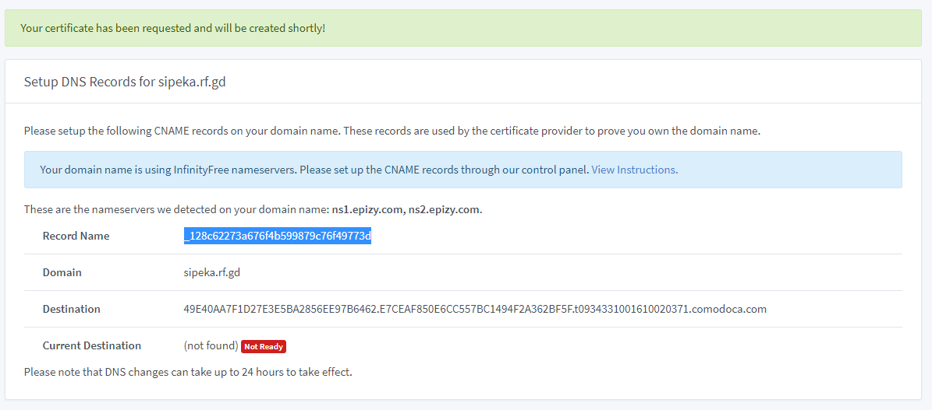
Cpanel – Deploy PHP Application

Slide 36
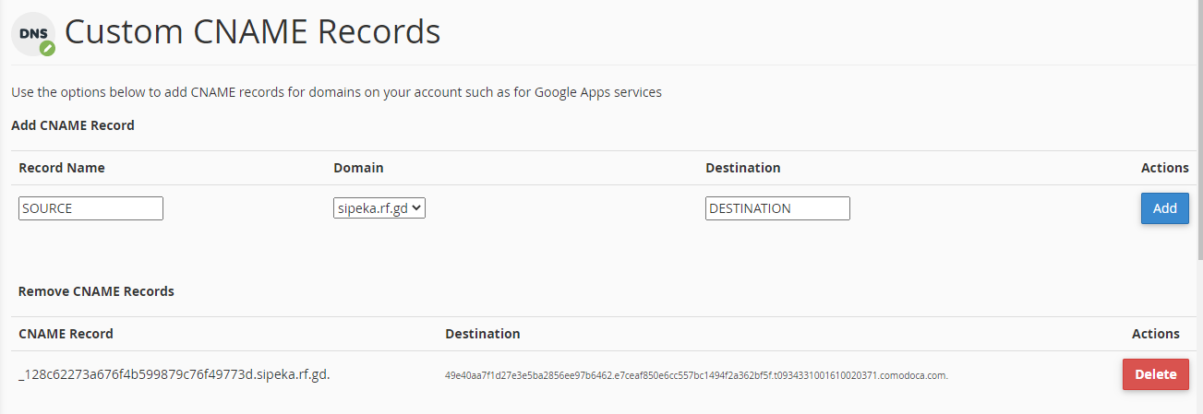
Cpanel – Deploy PHP Application

Slide 37
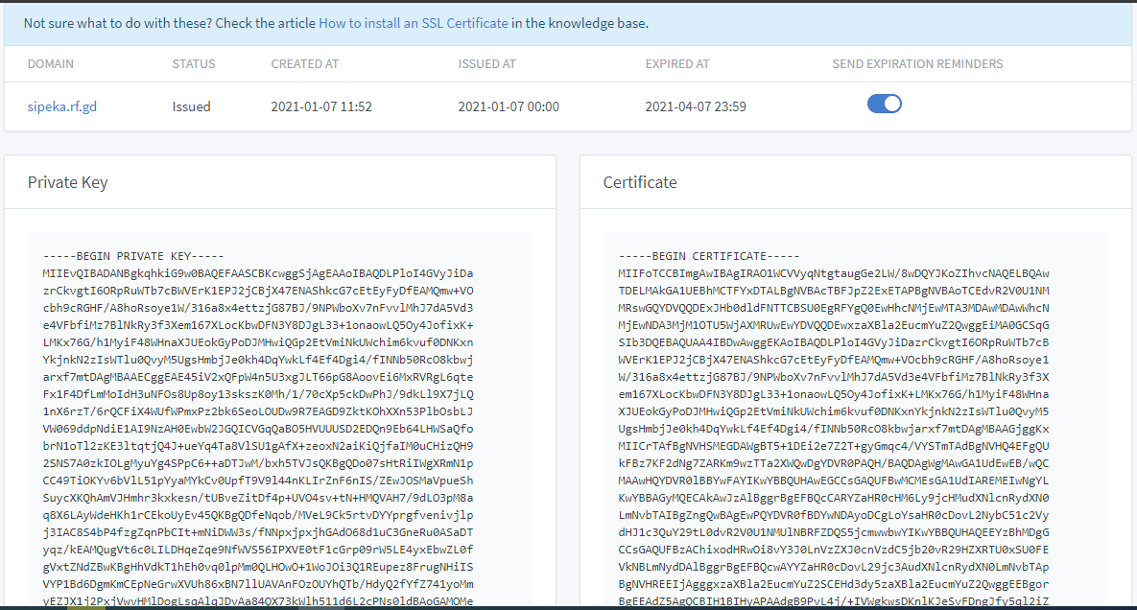
Cpanel – Deploy PHP Application

Slide 38
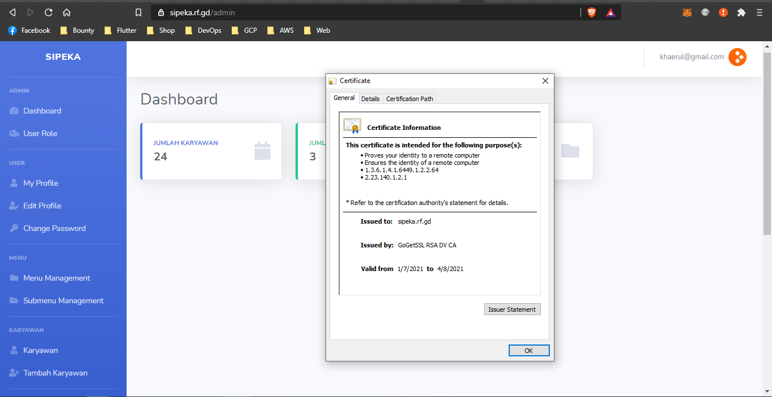
Cpanel – Deploy PHP Application

Slide 39
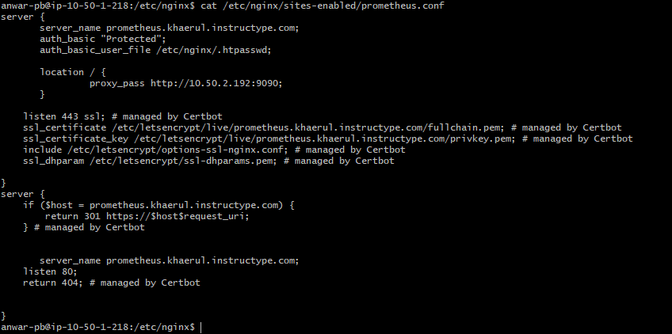
Optional Security

Slide 40
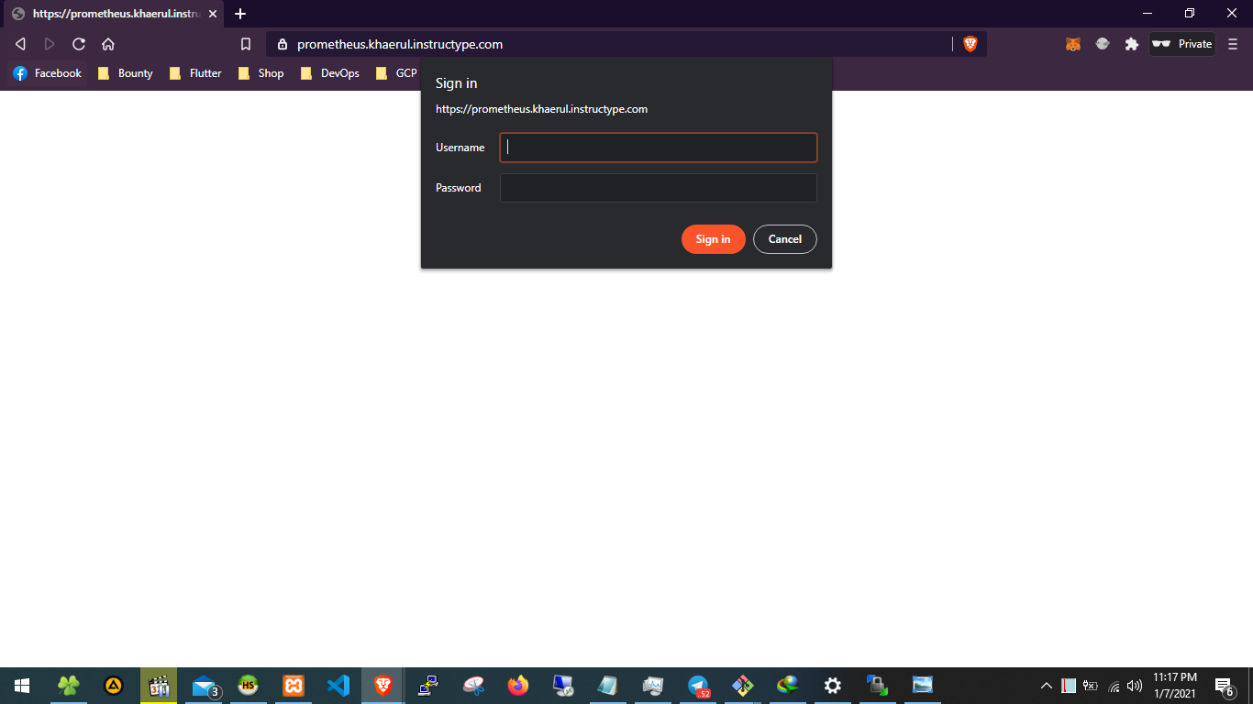
Optional Security

Slide 41
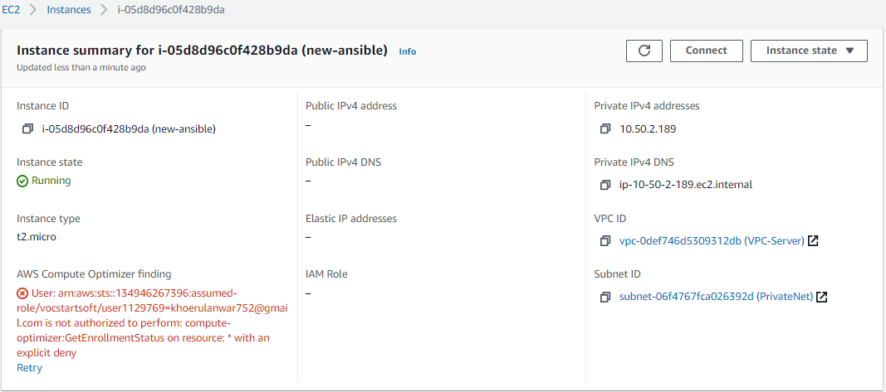
Ansible Server Automation

Slide 42
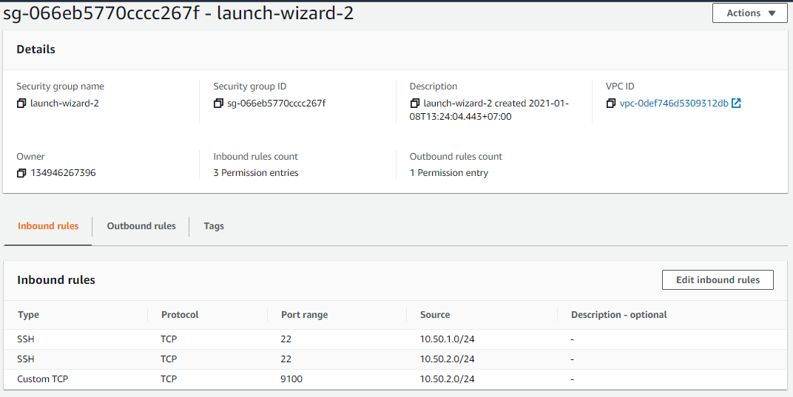
Ansible Server Automation

Slide 43
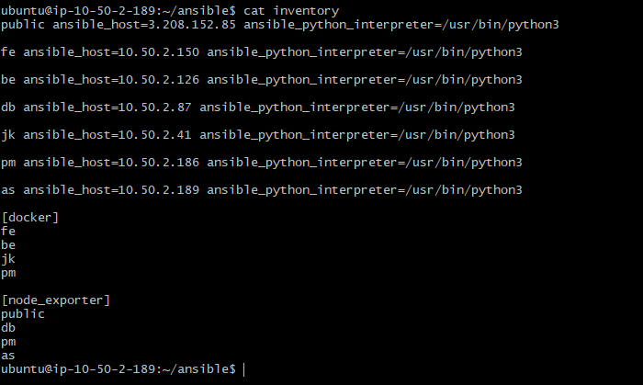
Ansible Server Automation

Slide 44
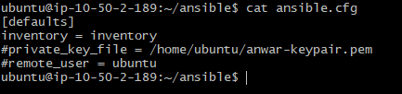
Ansible Server Automation

Slide 45
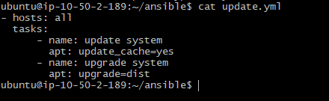
Ansible Server Automation

Slide 46
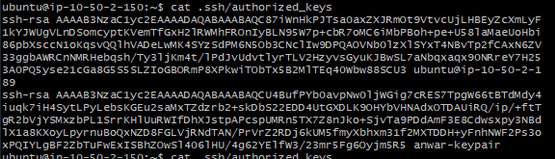
Ansible Server Automation

Slide 47
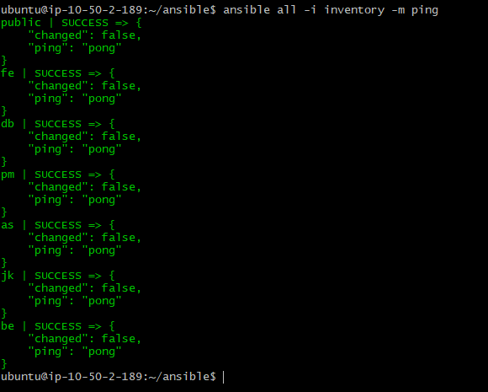
Ansible Server Automation

Slide 48
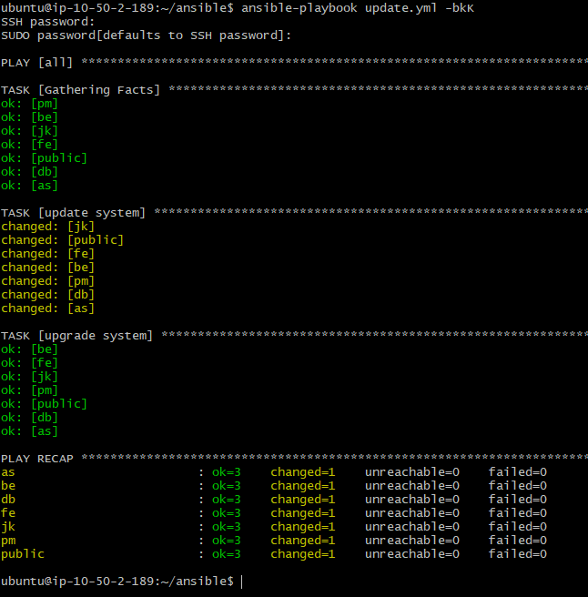
Ansible Server Automation

Slide 49
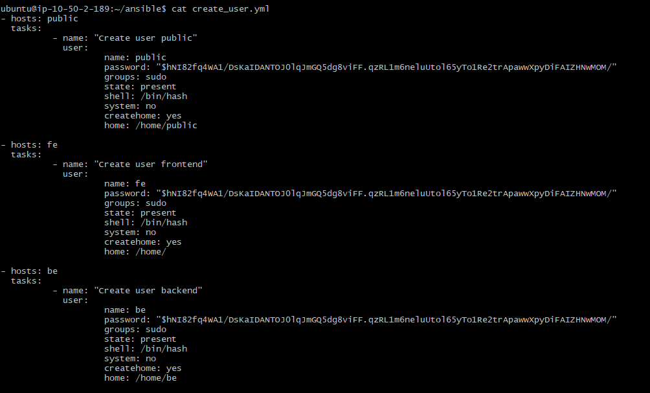
Ansible Server Automation

Slide 50
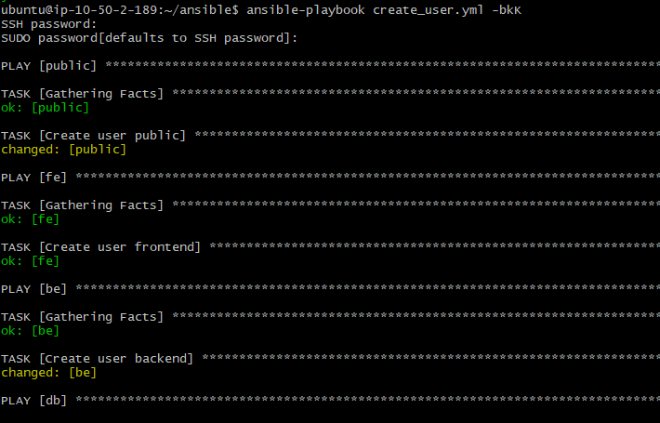
Ansible Server Automation

Slide 51
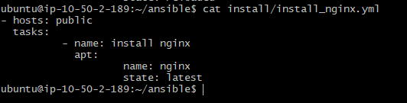
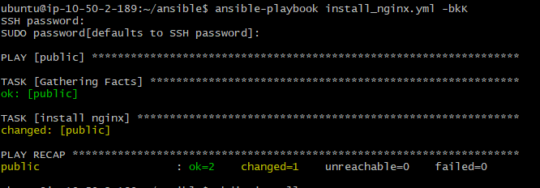
Ansible Server Automation

Slide 52

Ansible Server Automation

Slide 53

Ansible Server Automation

Slide 54

Ansible Server Automation

Slide 55


Ansible Server Automation

Slide 56

Ansible Server Automation

Slide 57

Ansible Server Automation

Slide 58

Ansible Server Automation

Slide 59

Ansible Server Automation

Slide 60

Ansible Server Automation

Slide 61

Ansible Server Automation

Slide 62

Ansible Server Automation

Slide 63

Ansible Server Automation

Slide 64

Ansible Server Automation

Slide 65

Ansible Server Automation

Slide 66

Ansible Server Automation

Slide 67

Ansible Server Automation

Slide 68

Ansible Server Automation

Slide 69

Ansible Server Automation

Slide 70
Quotations are commonly printed as a means of inspiration and to invoke philosophical thoughts from the reader.

Slide 71

THANKS!

